Slide 1
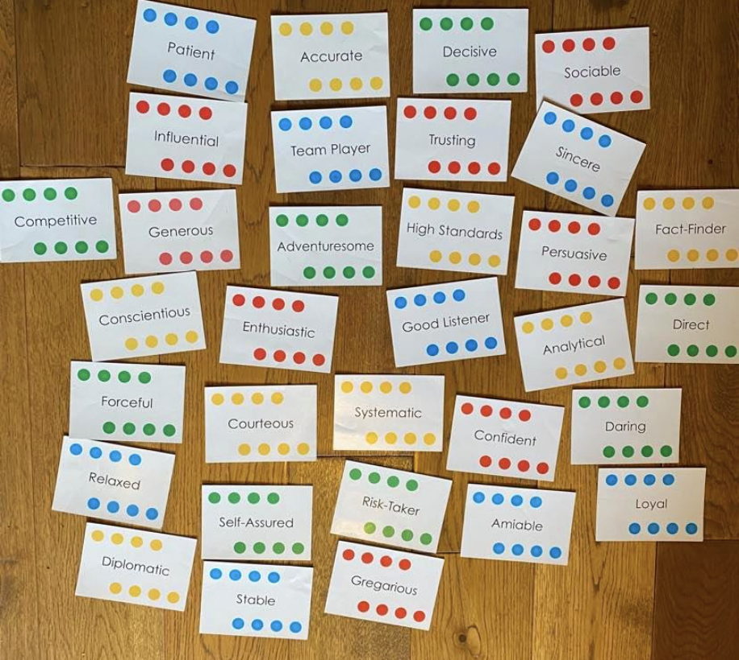

Slide 2

Fast-paced & Outspoken
Cautious & Reflective

Slide 3


Fast-paced & Outspoken
Questioning &
Sceptical
Accepting &
Warm
Cautious & Reflective

Slide 4
Questioning &
Sceptical
Accepting &
Warm

Slide 5


Fast-paced & Outspoken
Questioning &
Sceptical
Accepting &
Warm
Cautious & Reflective

Slide 6
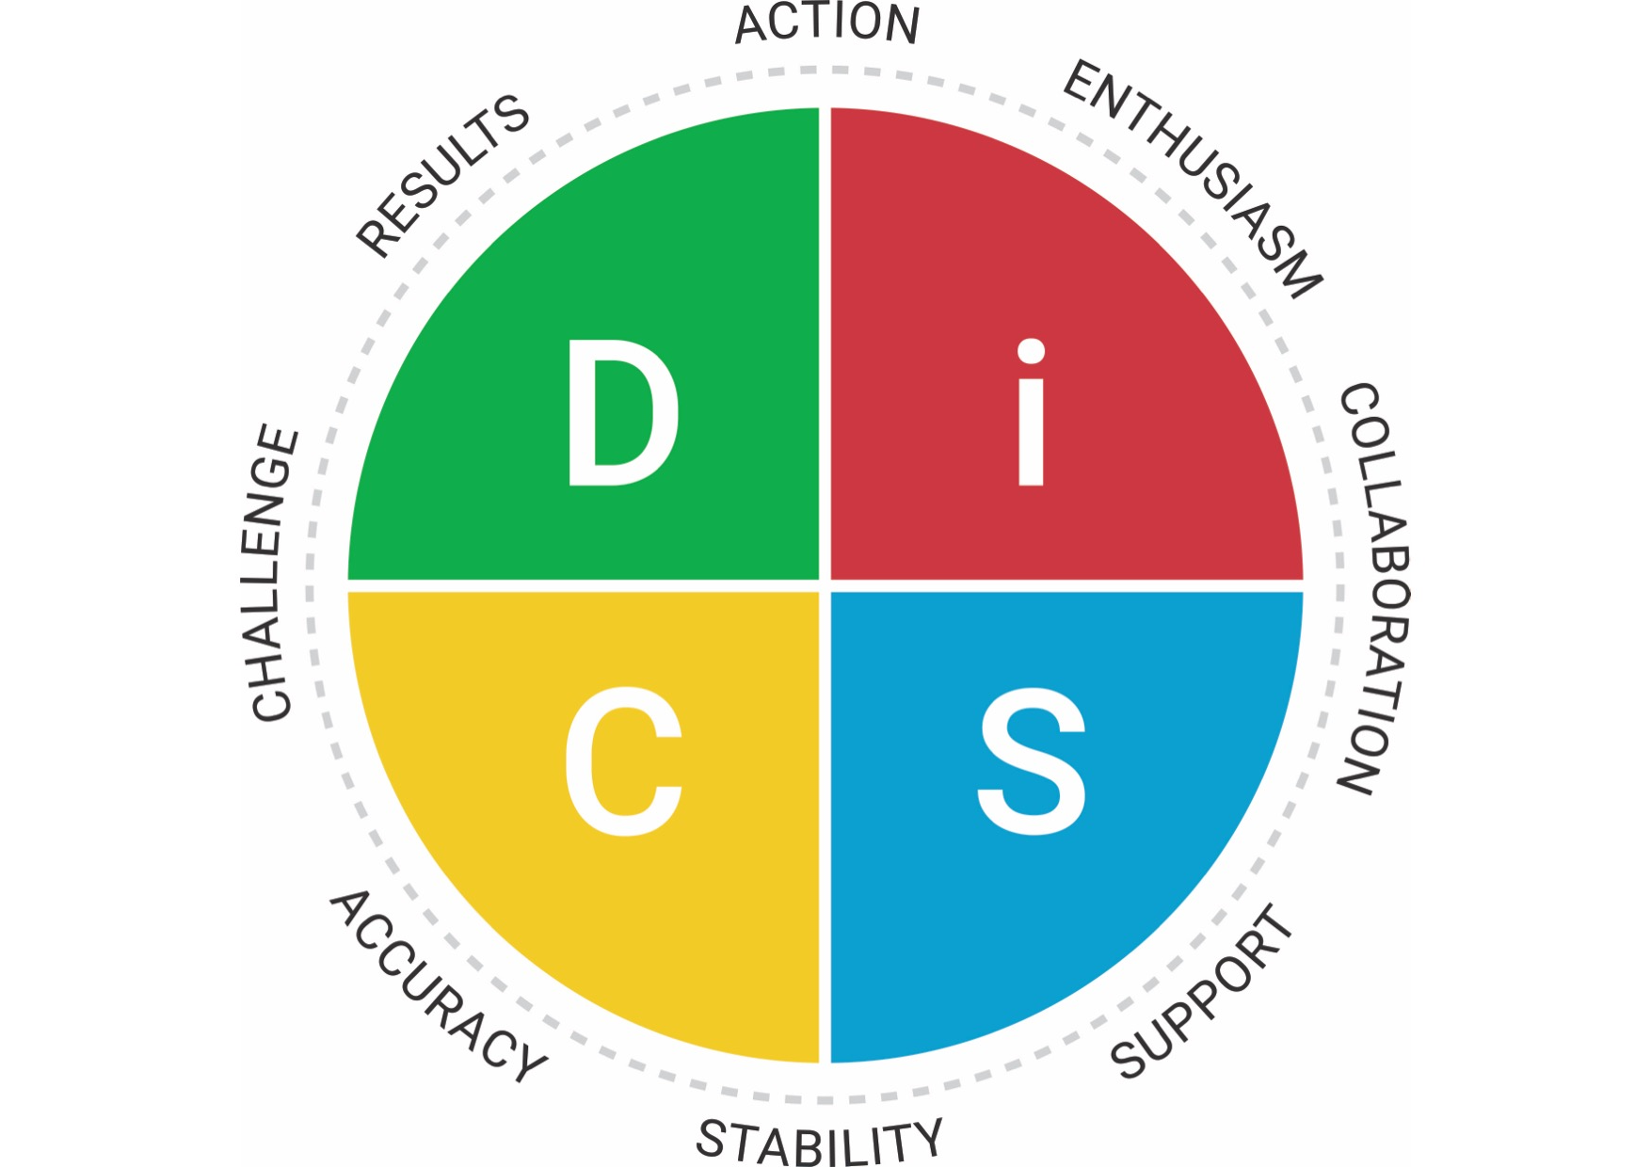
Direct
Self assured
Forceful
Adventurous
Daring
Risk taker
Decisive
Competitive
DOMINANCE
INFLUENCE
Influential
Persuasive
Confident
Trusting
Gregarious
Generous
Sociable
Enthusiastic
Fast-paced & Outspoken
Questioning &
Sceptical
Accepting &
Warm
Conscientious
High Standards
Accurate
Fact-Finder
Diplomatic
Systematic
Courteous
Analytical
Loyal
Sincere
Relaxed
Team-player
Amiable
Stable
Patient
Good listener
Cautious & Reflective
CONSCIENTIOUSNESS
STEADINESS

Slide 7


Address issues quickly and directly
Focus on the big picture
Get to the point quickly
Expect candour
Focus on results
Make efficient use of time
Be open to collaboration
Find ways to recognise them
Remain optimistic
Expect spontaneity
Build a relationship
Show and value enthusiasm
Use an objective, fact-based approach
Go through details
Focus on logic and facts
Expect scepticism
Emphasise high standards Show appreciation for their logic
Show warmth
Respect their cautious pace
Avoid forceful tactics
Show you care
Listen
Take an easy going approach

